Slide 1
세상 모든 자연과 통하다
GLOBAL ECO THE SAEM
Eco Soul Nail Collection

Slide 2
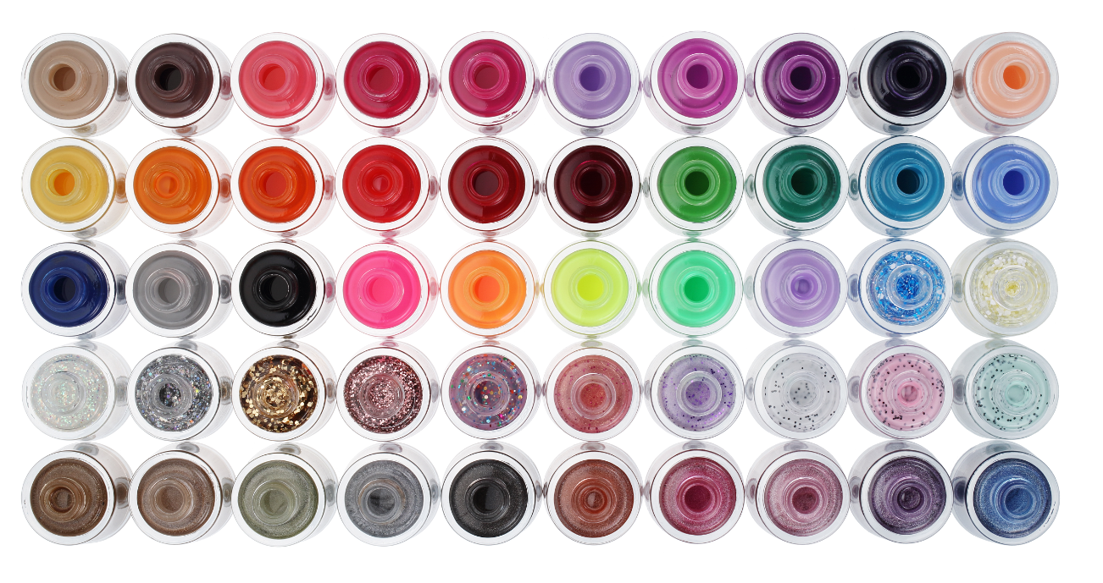
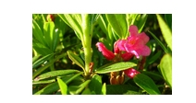
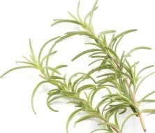
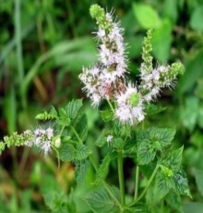
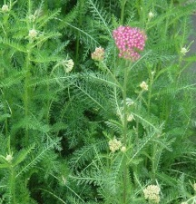
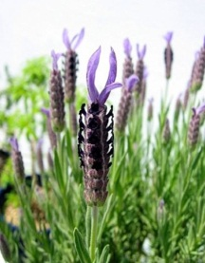
Profile of Eco Soul Nail polishes
Product Name | Eco Soul Nail Collection
Concept | “High-pigmented, High-shine, Long-lasting Premium Real Eco Nail” Various colors and texture selection such as outstanding glitter and hologram,. Treatment-enriched.
Features
Fragrance | [Herb Note] Fresh herb scent is used to disguise the unpleasant scent of general nail polishes.
Offers Gel-nail-like, high-shine.
Contains conditioning ingredients;
Black bean for extra nourishment
Blueberry extract for vitamin supply
Swiss Alpine Herb Complex and Ceramide to keep nail hydrated.
Mild formulation (Free of 4 additives, Paraben, Toluene, xylene, DBP)
Nature-inspired Colors : inspired by vivid colors of nature, Eco Soul Nail Collection presents the concept of Real Eco.
Easy-to-use flat, triangular shape brush.

Slide 3
Line Composition
Nail Colors [Total 50 SKU]
Name | SKU | Size | Price (won) | Image | Concept
Jelly | 23 | 10ml | 3,000 |  | Vivid color with dense and thick coat like gel nails.
LED | 7 |  | 3,000 |  | Strong, neon color that glows under the dark or LED light
Glitter | 10 |  | 3,500 |  | Eye-catching, luxurious textured glittery nail
Prism | 10 |  | 3,500 |  | Microglitter lacquer with ultra shine finish gives you nail glass-like effect.
Nail Remover & Nail Care
Name | SKU | Size | Price (won) | Image | Concept
Mild Remover | 1 | 150 ml | 5,000 |  | High quality nail remover without drying nails, not leaving whitish stains behind. Nail is fresh, hydrated after the color removal.
Peel-off Base | 1 | 10ml | 3,500 |  | Easy peel-off base for hard-to-remove glitter nail colors. Powerful lasting.
Quick Dry Multi Coat | 1 |  |  |  | Can be used as a base or top coat . Helps dry nails quickly.
Cuticle Essential Oil | 1 |  |  |  | Treatment for the cuticles and the skin around nails.
Cuticle Softener | 1 |  |  |  | Soften and ease the removal of cuticle
Matte Top Coat | 1 |  |  |  | Matte-finish top coat . When used as a base, it disguises discoloration of the nail while making the surface extra smooth.
Shine Pearl Top Coat | 1 |  |  |  | Offers elegant shimmer and luster in translucent layer.
Tone Changer Hardener | 1 |  |  |  | Nail hardener for weak and discolored nails. Offers healthy & naturally pinkish look.

Slide 4
Eco Soul Nail Collection Color Charts
JELLY
Color Name | Color | Color Name | Color | Color Name | Color | Color Name | Color
01. Beige |  | 07 Windy Purple |  | 13 Real Orange |  | 19 Emerald Blue
02. Choco Tart |  | 08. Orchid Plum |  | 14 Viva Red |  | 20 Freely Blue
03 Blooming Pink |  | 09 Dark Purple |  | 15 Red Show |  | 21 Deep Blue
04 Hot Pink |  | 10 Coral |  | 16 Dark Red |  | 22 Cloud Gray
05 Deep Pink |  | 11 Sunshine Yellow |  | 17 Pure Green |  | 23 Dark Black
06 Light Purple |  | 12 Cute Orange |  | 18 Forest Green
LED
Color Name | Color
01 LED Pink
02 LED Orange
03 LED Yellow
04 LED Green
05 LED Purple
06 LED Blue Sherbet
07 LED Lemon ade
GLITTER
Color Name | Color
01 Aurora
02 Twinkle Silver
03 Fancy Gold
04 Perfect Pink
05 Candy Pink
06 Pink Red
07 Soft Purple
08 Cookie & Cream
09 Cookie & Strawberry
10 Cookie & Mint
PRISM
Color Name | Color
01 Prism Brown
02 Prism Beige
03 Prism Green
04 Prism Silver
05 Prism Black
06 Prism Orange
07 Prism Red
08 Prism Purple
09 Prism Purple
10 Prism Blue

Slide 5
How To Use Care Products
Peel-off
Base
Most of glittery nail polishes are often difficult to remove. Peel-off Base is amazing base that forms a layer which you can peel off at once.
[Application]
Apply to clean and dry nails.
Apply one coat of Peel-off base.
Let it dry, follow with Eco Collection Glitter Nail.
[Removal]
Starting from the tip, gently peel off as if you peel off a sticker.
Wipe one more time with the nail remover.
Quick Dry Multi Coat
Fast-drying, double-performing base. It can be used as a base or a top coat.
Apply to clean, dry nails.
Let it dry then follow with colors.
Cuticle Essential Oil
Nourishing essential oil keeps cuticles hydrated and healthy.
Apply directly to dry cuticles and let it get absorbed naturally.
Use it regularly to maintain cuticles and nails healthy.
Cuticle Softener
Softens dry cuticles, making them easier to be removed.
Apply the softener around the nail contour
Let it soften for a minute, then gently push and cut the cuticle with
a pusher and a nipper.
Matte Topcoat
Matte finish, Shine-free top coat. Helps color stay longer.
Swipe on after applying any nail polishes to add matte-finish
[As a base]
If you have rough textured nail, apply the Matte Topcoat as a primer on dry nails.
It will create a smooth veil for even nail color application. After drying, follow with the polishes.
Shine Pearl Topcoat
Shimmering top coat that adds elegant and glamorous shimmer to any nail colors .
Helps color stay longer.
Swipe on after applying any nail polishes to add more shimmers.
Tone Changer Hardener
Nail Strengthener while giving nails the naturally-healthy look.
You can use it alone or as a base for other nail polishes.
Apply to clean and dry nails.
Let it dry and follow with colors.

Slide 6
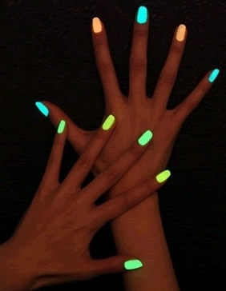
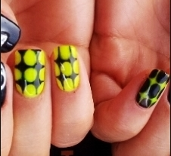
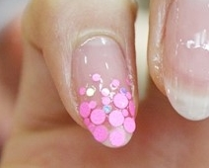
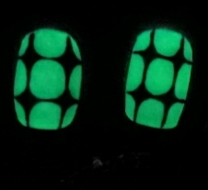
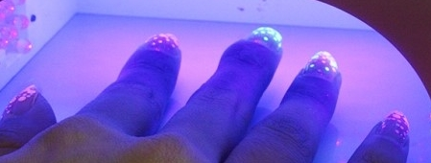
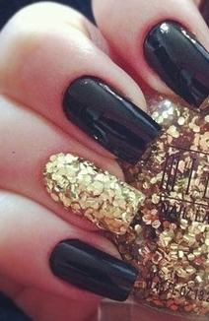
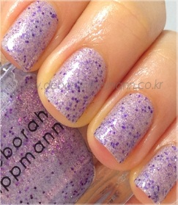
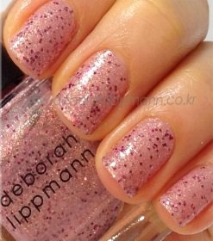
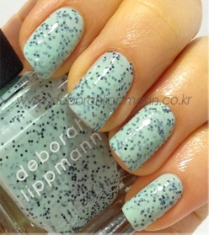
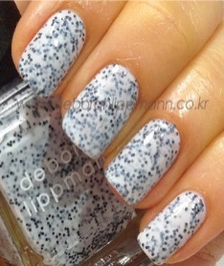
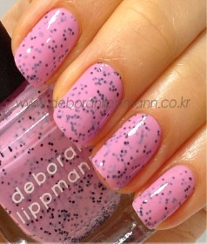
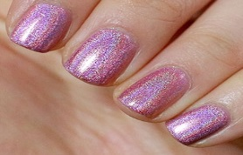
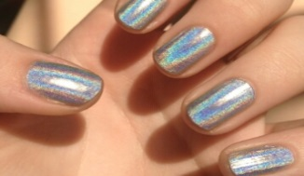
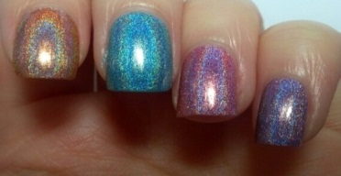
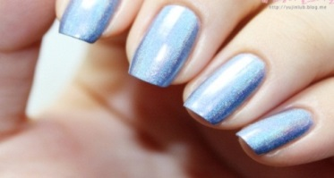
Application Ideas
LED Application Ideas
Under natural lights
Under natural lights
Under LED lights
Under LED lights
GLITTER Nail Application Ideas
PRISM Nail Application Ideas
Great Matching Colors
Trendy Orchid
Cool blue in day, Sexy glowing blue at night
Subtle elegant romance
Modern Chic Gray
[JELLY]
07 Windy Purple
[GLITTER]
07 Soft
Purple
[JELLY]
21 Deep Blue
[LED]
06 LED Blue Sherbet
[CARE]
Shine Pearl Top Coat
[GLITTER]
01 Aurora
[JELLY]
22
Cloud Gray
[PRISM]
04 Prism
Silver

